Slide 1
Big Mountain Ticket Pricing Model
Data Science Team: Analysis and Recommendations

Slide 2
Goal: Develop an Optimal Ticket Pricing Model
Big Mountain desires a predictive model for ticket pricing to:
Maximize returns relative to Big Mountain’s position in the market
Determine what features are most important to visitors
Determine what features visitors will pay more for
The pricing model, developed by the Data Science Team, will provide guidance for Big Mountain's pricing and future facility investment plans

Slide 3
Key Findings and Recommendations
Our Pricing Model supports raising Adult Weekend ticket prices from $81 to $100, a nearly 25% increase
Modeling the ticket price under new development supports:
An $0.81 increase for the new chairlift that was recently installed
An $0.81 increase if the vertical drop is increased by 150 ft without additional snowmaking coverage
Permanently closing up to 5 of the least used runs – closing down anymore would lead to a large drop in revenue

Slide 4
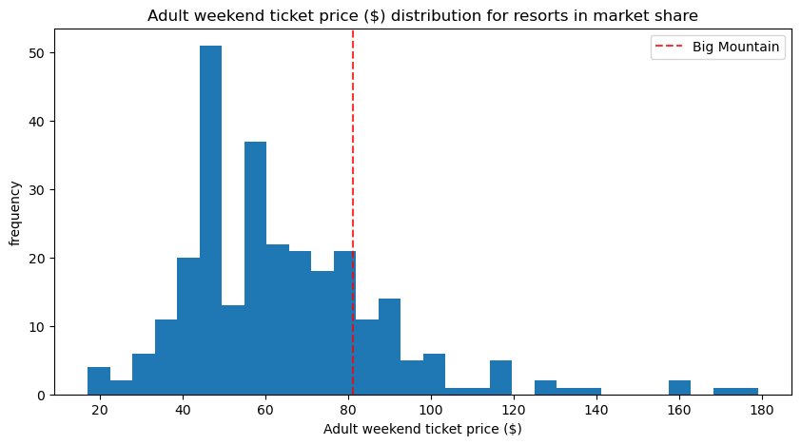
Pricing Analysis: High Level Takeaways
Using a Random Forest Regression model yields an optimal Adult Weekend ticket price of $100 with a Mean Absolute Error (MAE) of $10.39
Across the market, the average Adult Weekend ticket price is $64 with a MAE of $19. Our model has a much lower variability.
Out of data for 330 resorts received, 277 were retained for analysis. The rest were missing data for key features.
There is little variability in Montana between weekday and weekend ticket prices and there were more missing values in weekday prices across the dataset, so only weekend prices were modeled
Although no clear pattern was found between state and average price, it is noted that Montana resorts are in the bottom half of ticket prices

Slide 5
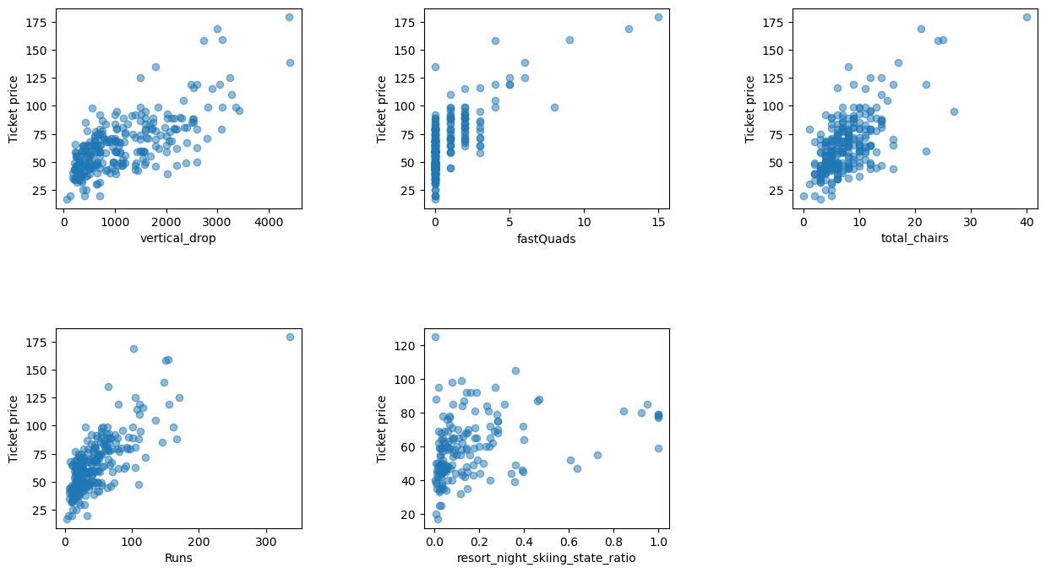
Pricing Analysis: Most Valuable Resort Features
Our model found these features to have the highest positive correlations to ticket price:
Vertical Drop
Fast Quads
Total Chairs
Runs
Night Skiing

Slide 6
Pricing Analysis: Big Mountain vs the Market
Reviewing Big Mountain’s ticket prices against our competitors with prices close to $81and with a target price of $100 is in line with our model results
Name | Vertical Drop | Fast Quads | Total Chairs | Runs | Night Skiing (acres) | Adult Weekend Ticket Price
Pico Mountain | 1967 | 2 | 7 | 59 | NaN | $81
Jiminy Peak | 1150 | 0 | 9 | 45 | 104 | $81
Schweitzer | 2400 | 2 | 9 | 92 | 100 | $81
Big Mountain Resort | 2353 | 3 | 14 | 105 | 600 | $81
Sunday River | 2340 | 4 | 15 | 135 | 140 | $105
Crystal Mountain | 3100 | 2 | 10 | 57 | NaN | $99
Diamond Peak | 1840 | 1 | 7 | 30 | NaN | $99

Slide 7
Summary and Conclusion
Based on our model, Big Mountain could raise Adult Weekend ticket prices from $81 to $100, an increase of almost 25%. An increase of this size would not go unnoticed by customers and would require a good marketing strategy.
This model serves as a good basis for further work on ticket prices. It could be expanded to include operating costs and other revenue streams.
The model could be made available to business analysts through a simple app that would allow users to enter different scenarios and add/remove rows of data to see the impact on ticket prices. The modeling team would not be required unless the feature set changed.

